Slide 1




TLIQ
HARDWARES
Business Insights 360
Domain/Function: Brick & Mortar and E-Commerce
AV
CREATED BY
V.ARUN KUMAR

Slide 2
Agenda
TLIQ
HARDWARES
1
Company Details
About AtliQ Hardwares Company Details
Problem Statement
2
Understand the business challenges faced by AtliQ Hardware’s(Imaginary Company) and the need for data analytics.
3
Project Overview
Define the project's objectives, scope, and key data sets to be analyzed.
INSIGHTS
4
Gain insights into from my observations and preliminary findings.
5
Dashboard Showcase
Explore interactive dashboards that visually represent key metrics and insights.

Slide 3
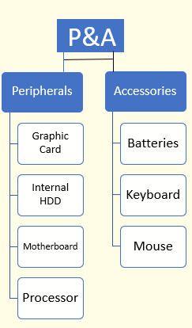
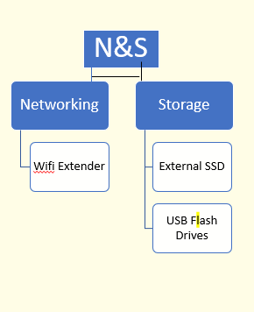
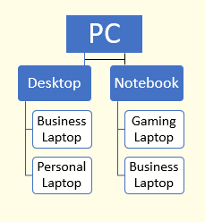
TLIQ
HARDWARES
COMPANY DETAILS
AtliQ Harwares(Imaginary Company) It’s a Consumer Goods and Electronics Company
FISCAL YEAR
ATLIQ HARDWARES PRODUCTS
FY_2018
SEPTEMBER(2017)-AUGUST(2018)
FY_2019
SEPTEMBER(2018)-AUGUST(2019)
FY_2020
SEPTEMBER(2019)-AUGUST(2020)
FY_2021
SEPTEMBER(2020)-AUGUST(2021)
FY_2022
SEPTEMBER(2021)-AUGUST(2022)

Slide 4

TLIQ
HARDWARES
Problem Statement
Business Growth
AtliQ Hardwares, is experiencing rapid growth but rely on excel files for data analytics, which is hindering effective insights and leading to potential losses.
Data Challenges
Excel files are hard to consume and not effective in generating insights. Also due to the lack of effective analytics the company faced a major loss
Latin America Loss
The company experienced a significant loss in the Latin American market, highlighting the need for improved data analysis to understand regional trends.
Data Analyst Role
As a Data Analyst I examine data to uncover significate insights and explore themes,and I will use various analytical tools to concise and Storytelling.

Slide 5

TLIQ
HARDWARES
Project Overview
1
Objective
Conduct a comprehensive analysis of AtliQ Hardware's data to identify key insights and improve business performance.
2
Focus
Analyze the data sets of fact_forecast_monthly, fact_sales_monthly, post_invoice_deduction, and pre_invoice_deduction.
3
Data Sets
Include detailed information about customer, market, product, freight cost, manufacturing cost, and gross price.
4
Data Corrections
Remove leading and trailing spaces, correct spelling errors, and eliminate duplicate data/names.

Slide 6

INSIGHTS
I’m begun analysis of AtliQ's data, diligently investigating key metrics and potential insights.

Slide 7
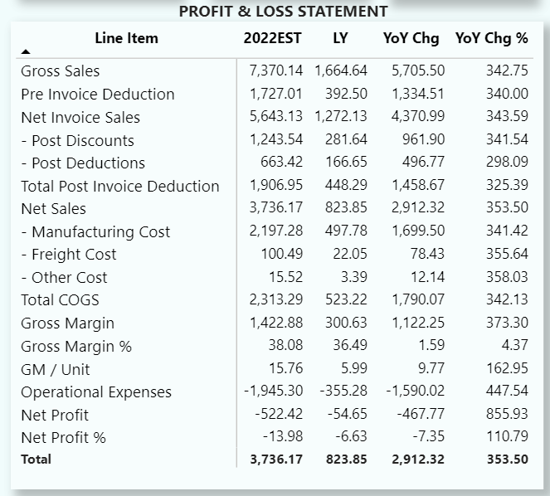
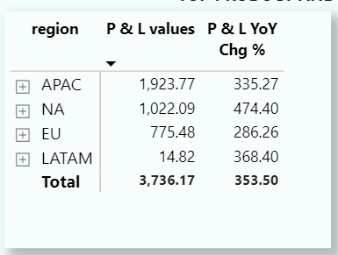
Economy View
Net Sales Increase
Compared to last year (2021), net sales have significantly increased by $2912M, indicating robust overall business performance.
APAC Region Performance
The APAC region leads with the highest net sales at
$1923M, highlighting the importance of this market for AtliQ.

Slide 8
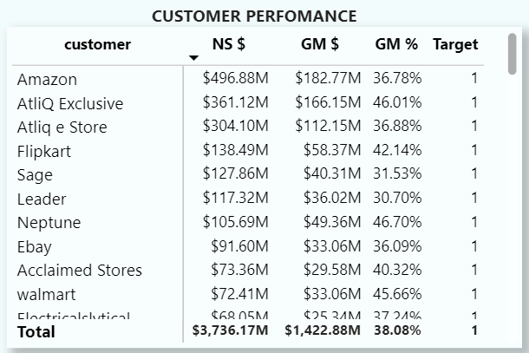
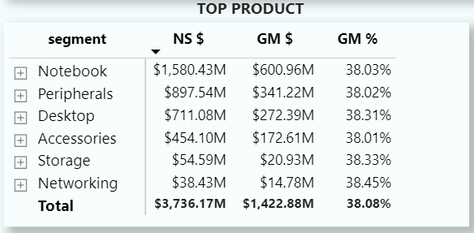
Sales View
Top Customer: Amazon
Top Product: Notebook
Amazon holds the highest net sales at $496.88M, demonstrating the importance of this major retailer to AtliQ's sales strategy.
Notebook products have generated the highest net sales at $1580.43M, highlighting the strong demand for this product category.

Slide 9
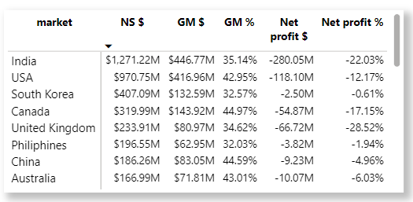
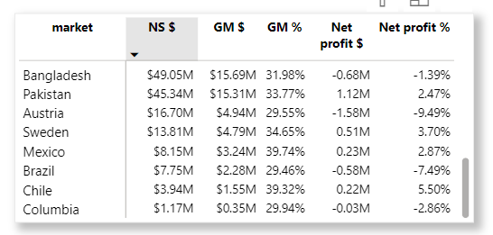
Marketing View
Top Market: India
India holds the highest net sales at $1271.22M, demonstrating the importance of this major retailer to AtliQ's sales strategy.
Bottom Market: Columbia
Columbia holds the Lowest net sales at $1.17.

Slide 10
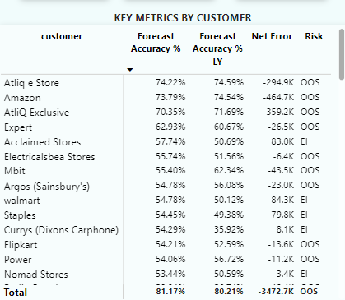
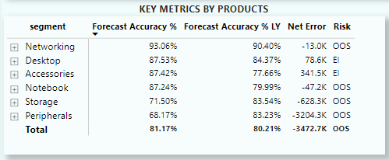
Supply Chain
Atliq e Store has the highest forecast accuracy among the Customers, with a forecast accuracy % of 74.22%.
Networking have the highest forecast accuracy among the product segments, with a forecast accuracy of 93.06%.

Slide 11
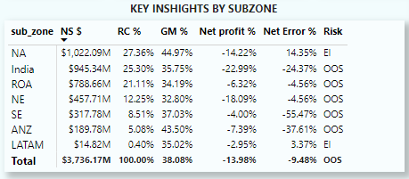
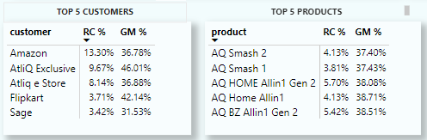
Executive View
North America have the highest Revenue Contribution among the Sub_Zone , with 27.36%
Amazon have the highest Revenue Contribution among the Customers, with 13.30%

Slide 12
DASHBOARD
CLICK HERE FOR DASHBOARD

Slide 13


TLIQ
HARDWARES
THANKYOU
HEMANAND SIR
DHAVAL PATEL SIR

